Slide 1
COMP 41400 Multi-Agent Systems (MAS) Lectures 1 & 2
Professor Gregory O’Hare,
Principal Investigator CONSUS (Crop OptimisatioN through Sensing, Understanding & viSualisation),
School of Computer Science
University College Dublin (UCD)

Slide 2
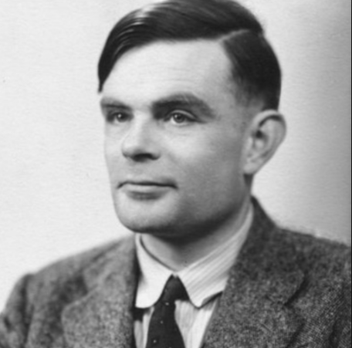
The Turing Test
Allan Turing [5] in his classic paper ‘Computing Machinery and Intelligence’, circumvented the problem of defining artificial intelligence.
Such a test took the form of a game….theTuring Test.
Born: June 23, 1912, Died: June 7, 1954, Wilmslow, United Kingdom

Slide 3
The Turing Test
The game he describes has three participants, an interrogator, a human and a machine. The interrogator is physically removed from the other two participants. He can communicate with each of them by way of a teletype, he does not however, know which participant is machine and which is human.
His task is to establish which one is the machine and which is the human. This became renowned as the ‘Turing Test’. A computer could be thought to display intelligence if the interrogator could not distinguish between man and computer.

Slide 4
The Turing Test II
Turing’s work did not, however, win universal acceptance.
More recently opponents like Millar [6] while recognising the merits of his work highlights the fact that it does not yield any insight into the various skills which constitute intelligence.
He believed this to be of great significance if any realistic attempt is to be made at constructing a truly intelligent machine.

Slide 5
The Turing Test
“The isolated man does not develop any intellectual power. It is necessary for him to be immersed in an environment of other men, whose techniques he absorbs during the first twenty years of his life. He may then perhaps do a little research of his own and make a very few discoveries which are passed on to other men.”
― Alan Turing

Slide 6
The Turing Test
“I've now got myself into the kind of trouble that I have always considered to be quite a possibility for me, though I have usually rated it at about 10:1 against. I shall shortly be pleading guilty to a charge of sexual offences with a young man. The story of how it all came to be found out is a long and fascinating one, which I shall have to make into a short story one day, but haven't the time to tell you now. No doubt I shall emerge from it all a different man, but quite who I've not found out.”
Alan Turing

Slide 7
Searle’s Chinese Room (1980)
Strong AI Advocates believe:
The appropriately programmed computer with the right inputs and outputs would thereby have a mind in exactly the same sense human beings have minds.
The Chinese Room (Searle):
Postulated by John Searle in his paper, "Minds, Brains, and Programs", published in Behavioral and Brain Sciences in 1980. It was a thought experiment.
A human enters a locked room but knows no Chinese (written or spoken).
He is given a set of rules (in English) that define a mapping between sets of symbols (Chinese characters).
These rules allow him to respond to inputs (written in Chinese) with outputs (also written in Chinese)…
Does the machine literally "understand" Chinese? Or is it merely simulating the ability to understand Chinese?[6][c] Searle calls the first position "strong AI" and the latter "weak AI"

Slide 8

The Turing Test II
If I may paraphrase Leonardo de Vinci (1452-1519), he in a similar vein suggested that.........
“when man understands the natural flight of the bird,
man will be able to build a flying machine.”

Slide 9
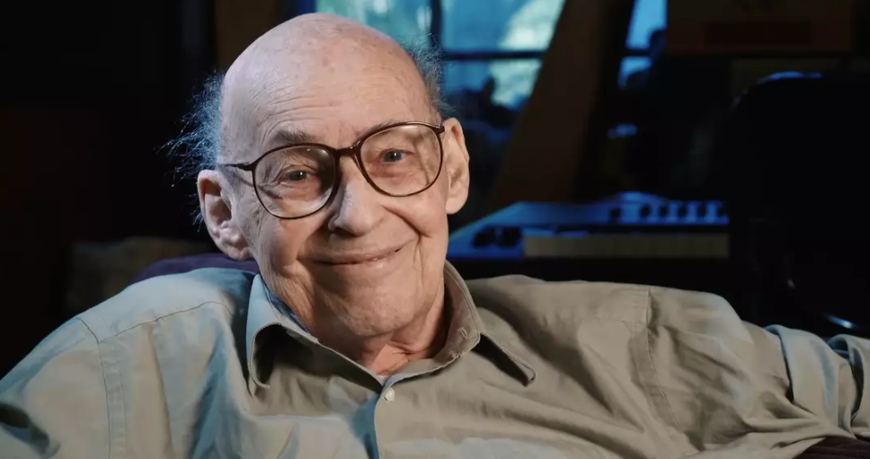
A Working Definition
So with artificial intelligence, the definition we shall employ is that volunteered by Marvin Minsky [7]
“Artificial intelligence is the science of making machines do things that would require intelligence if done by man.”
Marvin Minsky
Born August 9, 1927, New York City,
Died: January 24, 2016, Boston, Massachusetts

Slide 10

A Useless Machine !!!

Slide 11
A Simple Example
E
4
F
7
"If there is a vowel on one side of a card then
there will be an even number on the other"
How many cards must you turn over in order
to test the validity of this statement?

Slide 12


The Case for Knowledge Representation
1
8
6
4
5
9
2
7
3
Players alternatively choose a card
until they select three cards in total
The Object of the Game is to obtain a total of 15 and ensuring
your opponent does not acquire a total of 15.
What strategy would you adopt?

Slide 13

Things to Do!
Watch Marvin Minsky Interview:
https://www.youtube.com/watch?v=EI0NXTrS5Pw

Slide 14
Lecture II Objectives
To introduce the origins of AI;
To consider if machines can Think;
To examine the simple operation of a Knowledge Based
/Expert System;
To describe the Knowledge Engineering Lifecycle;

Slide 15
A Short History of AI
The term Artificial Intelligence is normally attributed
to John McCarthy.
In 1956 he organised a conference which was to enable
researchers in the field to share expertise.
As a consequence of his actions the discipline of AI
was founded.
Some attendees namely, Allan Newell, Herbert Simon
and Marvin Minsky himself, are now without question
the leading researchers in the field.

Slide 16
A Short History of AI
“Every aspect of learning or other feature of intelligence can in principle be so precisely described that a machine can be made to simulate it.”
Mission statement of the Dartmouth Conference, 1956

Slide 17
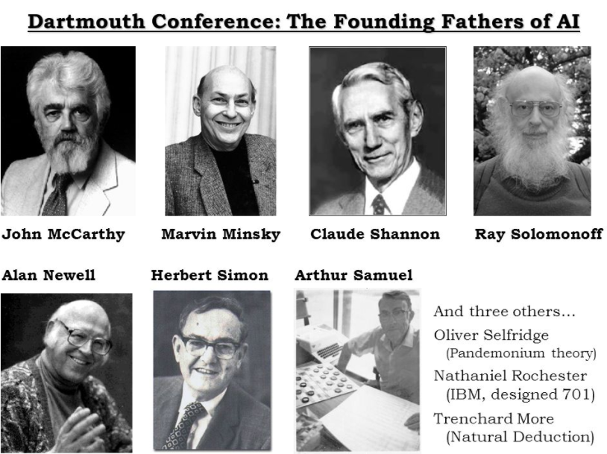
A Short History of AI

Slide 18
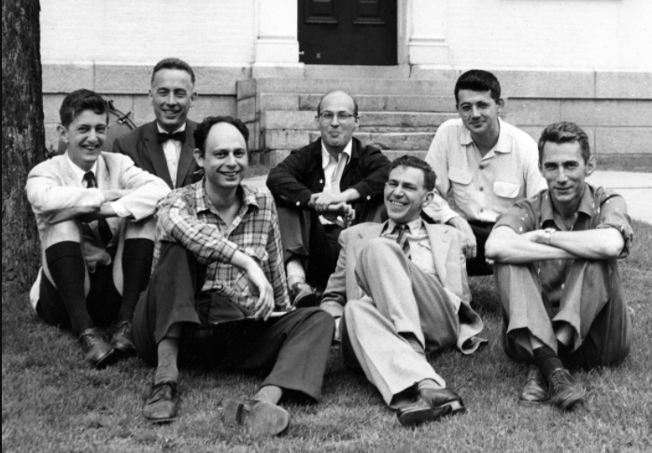
The History of AI 2
At the conference Newell & Simon detailed work on the theorem prover which had been performed at Carnegie.
This is commonly regarded as the first AI program as such.
The Logic Theorist was written in IPL (Information Processing Language) the first language which permitted computers to process concepts as opposed to numerical quantities.

Slide 19
Inaugural AI Conference in 1956
Alan Newell & Herb Simon: Logic Theorist
Proved 38 out of 52 theorems from Chapter 2 (The Theory of Logical Types) of Principia Mathematica.
Based on logic
Reasoning as Search (search spaces)
Use of Heuristics
Information Processing Language (IPL) - precursor to Lisp
Widely accepted as the first AI program…

Slide 20
The History of AI 3
Minsky & McCarthy founded the MIT AI Laboratory.
McCarthy is renowned as the inventor of LISP while Minsky
proposed the Frame concept for Knowledge Representation.
In this early stage efforts tended to concentrate on:
Game Playing: equipping a computer to play a
particular game.
Theorem Proving: equipping a computer to show that
some statement follows logically from a set of
known truths called axioms.

Slide 21
Expert Systems: Shrdlu 1968-70
A program that understands a subset of English and can manipulate some wooden blocks.
Implemented using Micro Planner (Carl Hewitt, 1969) & Lisp (McCarthy, 1958)
Micro Planner (precursor to Prolog) provided a logical reasoning engine based on Resolution (Robinson, 1965)
Lisp provided support for procedural code.
Users interact with Shrdlu via a command line.
Shrdlu parses the user input and responds appropriately.
This can involve manipulating the blocks or responding to some user query…

Slide 22
Expert Systems: Shrdlu 1968-70
Person: Pick up a big red block.
Computer: OK.
Person: Grasp the pyramid.
Computer: I don't understand which pyramid you mean.
Person (changing their mind): Find a block which is taller than the one you are holding and put it into the box.
Computer: By "it", I assume you mean the block which is taller than the one I am holding.
Computer: OK.
Person: What does the box contain?
Computer: The blue pyramid and the blue block.
Person: What is the pyramid supported by?
Computer: The box.
Person: How many blocks are not in the box?
Computer: Four of them.
Person: Is at least one of them narrower than the one which I told you to pick up?
Computer: Yes, the red cube.

Slide 23
The History of AI 4
Early efforts employed a technique known as State Space Search
involving essentially several components ...
(a) an initial stage
(b) a final state
(c) an ability to detect final state
(d) a set of legal operations that can be applied to each state.
Such an approach can often be understood better by conceptually
regarding states as nodes and operations as arcs.

Slide 24
The History of AI 5
By way of example in a chess game:
(a) initial state: initial state of chess board.
(b) final state: checkmate.
(c) ability to detect final state: ability to detect checkmate.
(d) set of legal operations: legal moves of chess.

Slide 25
Generate & Test 1
The simplest form of state space search is that of Generate & Test.
Such an approach involves typically three stages, those of ...
(a) Generating a possible solution in the form of a new state.
(b) Ascertaining whether the new state is indeed the final state.
(c) If new state is the final state terminate, otherwise
repeat steps a, b and c.

Slide 26
Generate & Test 2
Two forms of generate and test exist: Depth-first Search & Breadth-first Search.
Both fall foul of the ‘combinatorial explosion’, caused by the
exponential growth of the nodes irrespective of the order of generation.
Consequently exhaustive search is only feasible when the search space is very small.
For larger spaces the search needs to be guided.
Guided searches are normally referred to as Heuristic Searches.
Searches of this nature utilise domain specific knowledge
called heuristics.

Slide 27
Guided Searches
Guided searches are normally referred to as:
Heuristic Searches.
Searches of this nature utilise:
domain specific knowledge called heuristics.

Slide 28
Exercise 1
Attempt to draw a state space for the famous
Missionaries and Cannibals problem

Slide 29
The Development of Expert Systems 2
Stanford Profesor, Terry Winograd developed the Shrdlu expert system which was able to understand a subset of English an manipulate wooden blocks.
Soon after came numerous other systems targeting a diversity of domains.
Researchers became aware that the representation of knowledge was central to achieving a truly intelligent system.
Thereafter numerous formalisms were proposed.

Slide 30
The History of AI Research
In 1973 a report by Sir James Lighthill concluded that AI work
within the UK was unproductive. There ensued a removal of
government funding. Referred to as the AI Winter.
Consequently the US and Japan dominated AI research for a
period gaining predominance .
In later years expert systems emerged which
offer a high level of performance in complex domains.
Examples include XCON & MECHO.
R1/XCON delivered the first commercial return on AI by 1986
delivering circa $40 Million per annum.

Slide 31
The History of AI Research
In 1987 Deep Blue defeats Gary Kasparov world chess champion.
IBM shares soar in value. Regarded as a coming of age for AI.
In 2011 IBM’s Watson challenged humans on a Quiz show
entitled Jeopardy. But not any contestants the two best all time
performers on the show.
This presented a much greater challenge than simply chess.
Trained the computer for 23 years to recognise patterns in
questions and answers.
Hailed as a seminal juncture for AI

Slide 32
Can Computers Think?
Throughout the evolution of artificial intelligence there have been many opponents to the whole concept of machines generating anything original.
Turing identified many of these objections:
Theological objection: suggests only the possession of a soul permits thought, hence machine nor animals can think.
Mathematical objection: based on Godel’s theorem claims limitations to the power of artificial systems.
Lady Lovelace’s objection: Raphael amongst others claims that a computer can only do what it is told and thus it cannot have pretentions to originate anything (derived intentionality).

Slide 33
Can Computers Think?
Other Objections:
Arithmetic Machine objection: a computer is little more than a fast arithmetic machine. Of course a computer can achieve more than merely arithmetic operations: SHIFT, READ, COMPARE, LOAD etc.
Informality of Behaviour objection: impossible to detail set of rules which indicate how a person should act in all possible situations.
Sensory Perception objection: humans have senses not available to machines sight, touch, smell, ESP.
Head in the Sand objection: too horrendous even to contemplate that computers could think.

Slide 34
Contradicting the Objections
Numerous examples, however, may be cited to contradict this.
Samuels checker program, primitive learning capacity
Lenats AM, which identified new maximally divisible
Numbers not considered by most mathematicians.
Prospector , which was claimed to be in error in certain
circumstances, but was eventually proven to be right.

Slide 35
Can Computers Think?
Thought, origination of new knowledge.
Consider a computer is given the following pieces of knowledge:
Elephants are large and grey
Clyde is an elephant.
Conceptually we can think of this knowledge as a graph. If in
addition we armed the computer with the technique:
properties may be inherited following the directed arcs.
Hence it could conclude a new item of knowledge
Clyde is Large and Grey
Is this equivalent to thought? The computer only used
techniques we equipped it with, but after all we only use skills
we acquire from our environment.
Can a computer exhibit emotions or indeed have morals?

Slide 36
Things to Do!
Johnson-Laird, P.N. (1983). Mental Models: Towards a Cognitive Science of Language, Inference, and Consciousness. Cambridge: Cambridge University Press.
Johnson-Laird, P.N. (2006) How We Reason. Oxford University Press

Slide 37
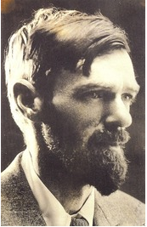
Conclusion: To Dream by Day
“All people dream, but not equally. Those who dream by night in the dusty recesses of their mind, wake in the morning to find that it was vanity.
But the dreamers of the day are dangerous people, for they dream their dreams with open eyes, and make them come true.”
D.H. Lawrence

